Slide 1

Module 9: Monitoring Resource Use

Slide 2

Website: www.rc.colorado.edu
Documentation: https://curc.readthedocs.io
Helpdesk: rc-help@colorado.edu
2
2

Slide 3









Meet the User Support Team
Layla Freeborn
Brandon Reyes
Andy Monaghan
Michael Schneider
John
Reiland
Dylan Gottlieb
Mohal Khandelwal
Ragan
Lee
3

Slide 4
Learning Objectives
Calculate your resource usage/consumption
View average wait times in the CURC queues
Find your relative "priority”
Check the efficiency of your research workflows
4

Slide 5
Overview
1
2
slurmtools
XDMoD
5

Slide 6

Overview
1
2
slurmtools
XDMoD
6
Notes:
Slurmtools – monitor your jobs and SU’s
XDMoD – observe jobs on the cluster

Slide 7
The slurmtools Module
Available commands
seff-array
A module that loads a collection of functions to assess recent usage statistics
suacct
jobstats
$ module load slurm/alpine
$ module load slurmtools
suuser
levelfs
seff
7
Notes:
can be accessed from any node
need to load slurm/blanca for blanca usage info

Slide 8
jobstats
What jobs have I run over the past N days?
$ jobstats
Purpose: This function shows statistics for each job run by a specified user over N days.
Usage: jobstats [userid] [days, default 5]
Hint: jobstats ralphie 15
8

Slide 9



Service Units
SU = x
Service units (SUs), sometimes called “core hours”, reflect the processing that a core performs in one hour modified by some scaling factor

Slide 10
suuser
How many Service Units (SUs) have I used?
$ suuser
Purpose: This function computes the number of Service Units (SUs) consumed by a specified user over N days.
Usage: suuser [userid] [days, default 30]
Hint: suuser ralphie 15

Slide 11
suacct
Who is using all the SUs on my group’s account?
$ suacct
Purpose: This function computes the number of Service Units (SUs) consumed by each user of a specified account over N days.
Usage: suacct [account_name] [days, default 30]
Hint: suacct ucb-general 15

Slide 12
seff
How efficient are my jobs?
$ seff
Usage: seff [Options] <Jobid>
Options:
-h Help menu
-v Version
-d Debug mode: display raw Slurm data

Slide 13
seff-array
How efficient are my array jobs?
$ levelfs
usage: seff-array.py [-h] [-c CLUSTER] [--version] jobid
positional arguments: jobid
options:
-h, --help show this help message and exit
-c CLUSTER, --cluster CLUSTER
--version show program's version number and exit

Slide 14
Priority
A job’s priority determines its position in the queue.
A job’s priority is based on multiple factors, including:
FairShare score
Age
Resources requested
Job size
QOS

Slide 15
levelfs
What is my priority?
$ levelfs
Purpose: This function shows the current fair share priority of a specified user.
A value of 1 indicates average priority compared to other users in an account.
A value of < 1 indicates lower than average priority
(longer than average queue waits)
A value of > 1 indicates higher than average priority
(shorter than average queue waits)
Usage: levelfs [userid]
Hint: levelfs ralphie

Slide 16

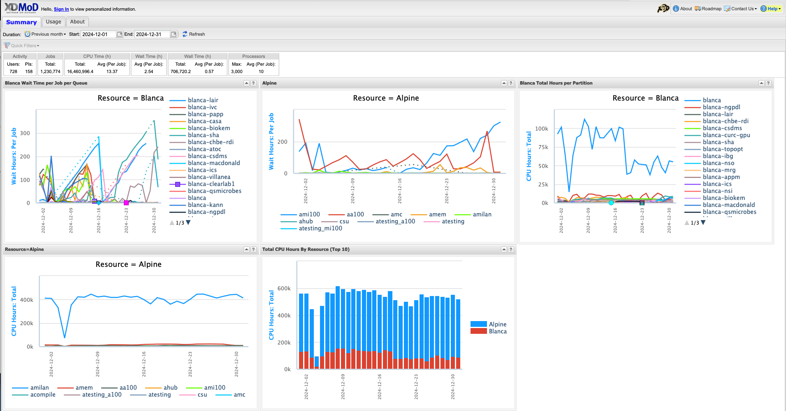
XDMoD
https://xdmod.rc.colorado.edu/
Notes:
XDMoD is a web portal for viewing metrics at the system, partition, and user levels.

Slide 17
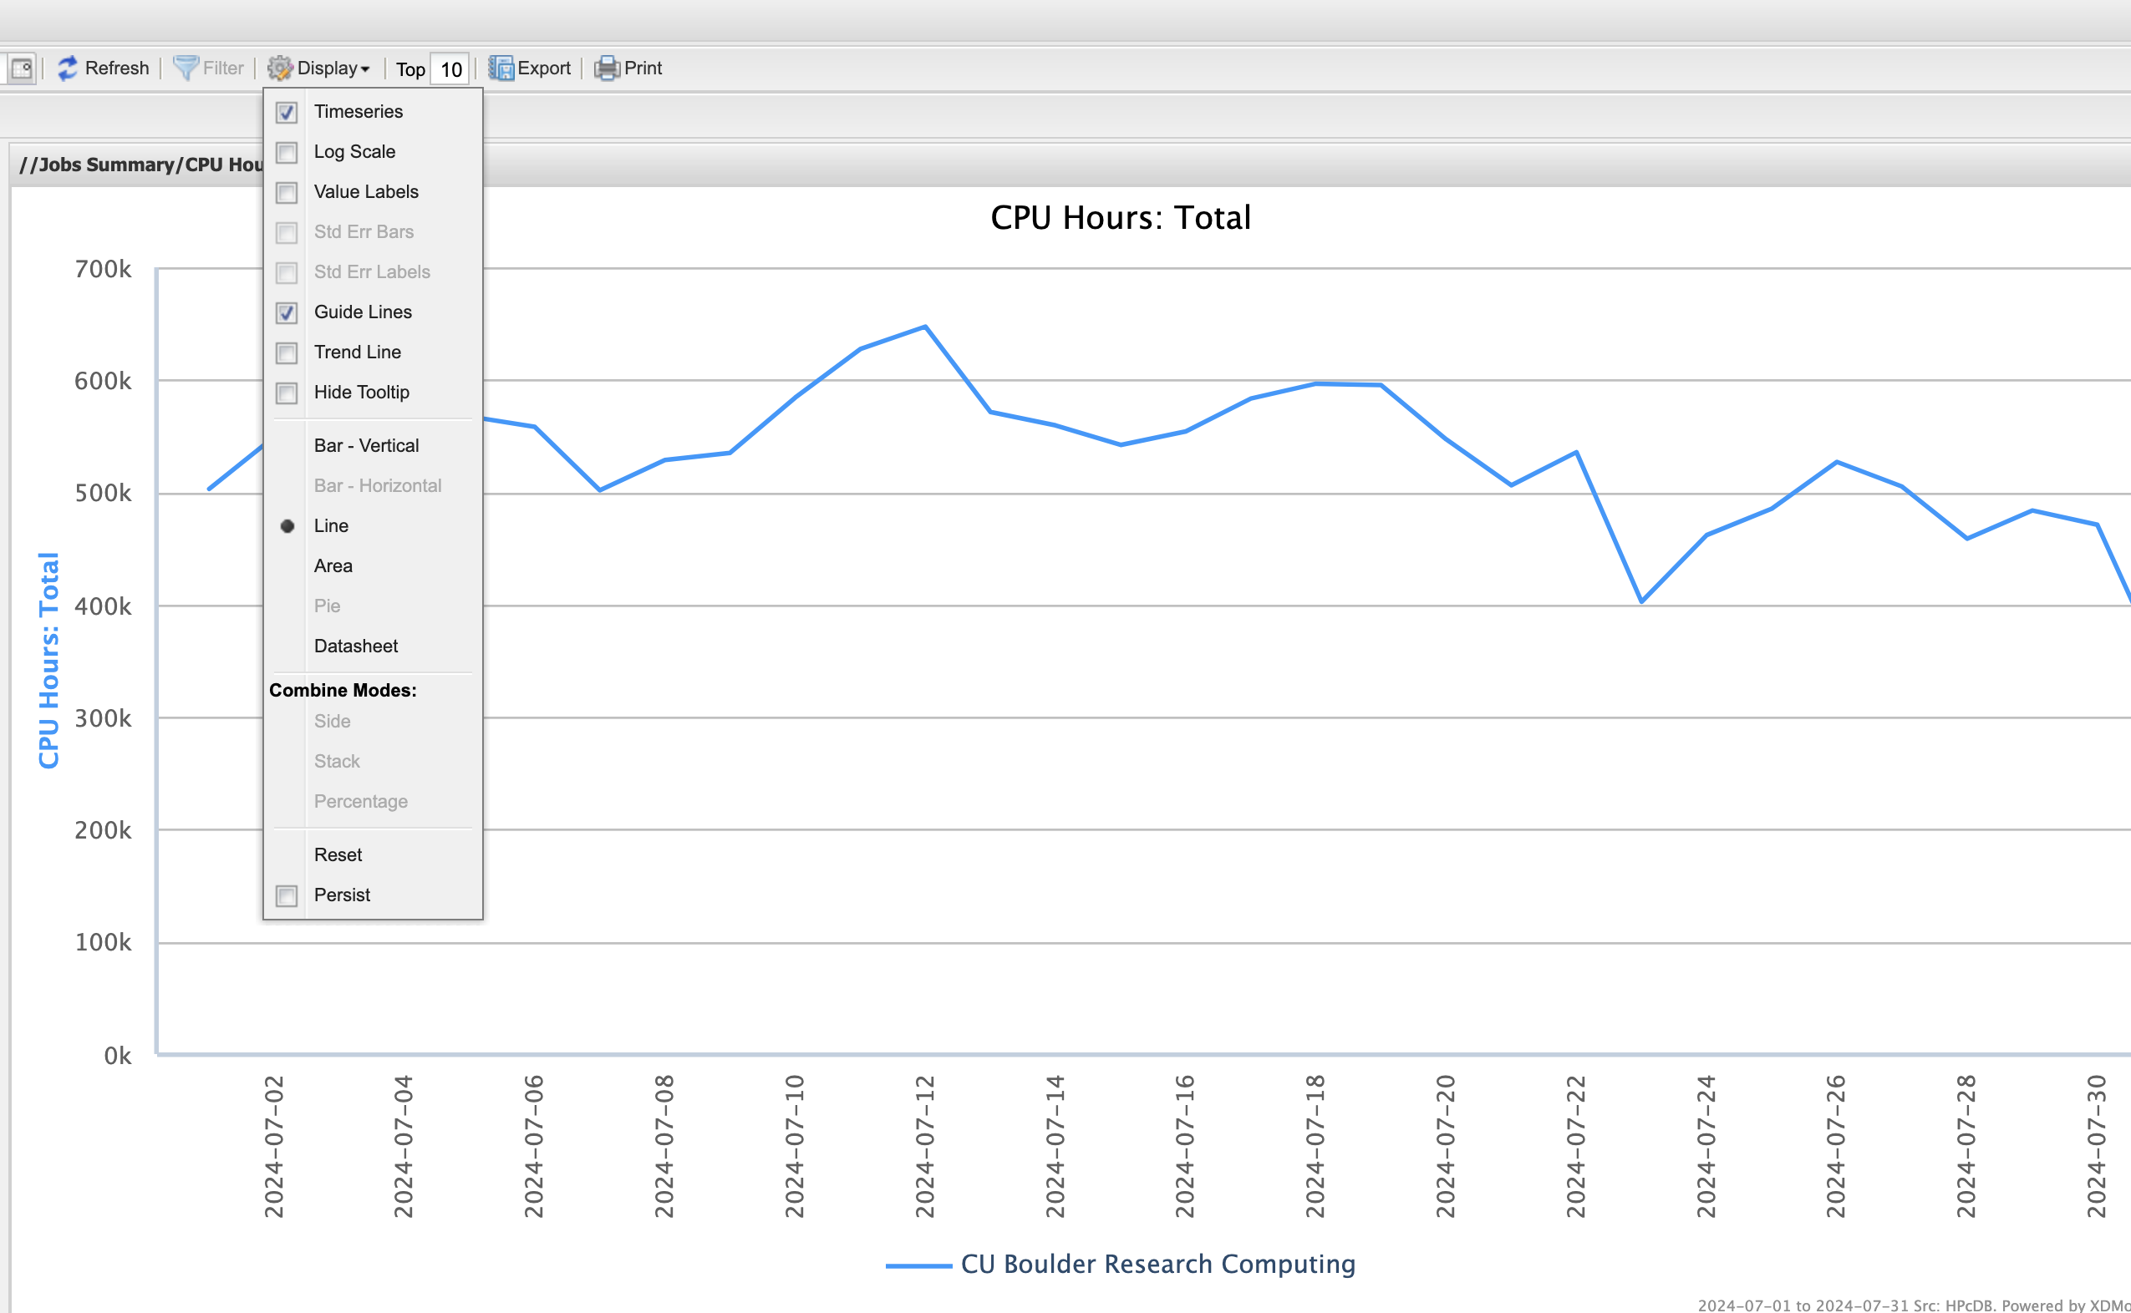
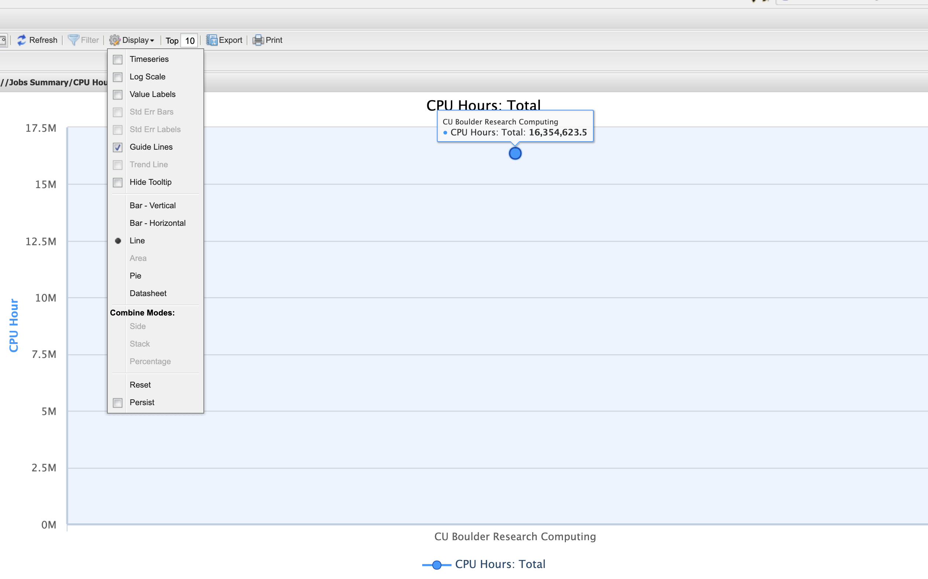
XDMoD Display Menu Defaults
Display Menu: timeseries checked (default)
Display Menu: timeseries unchecked

Slide 18
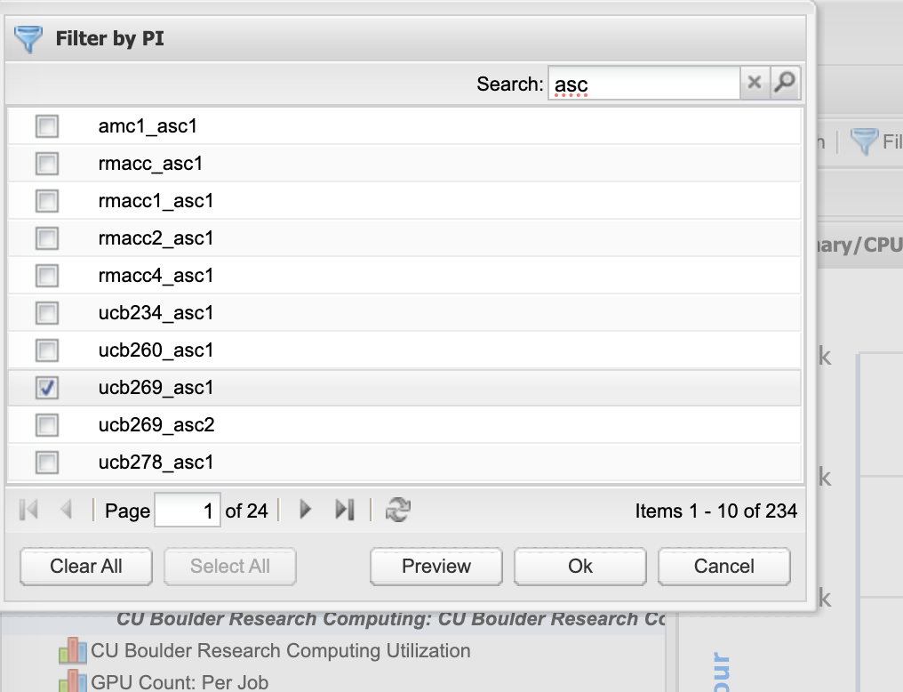
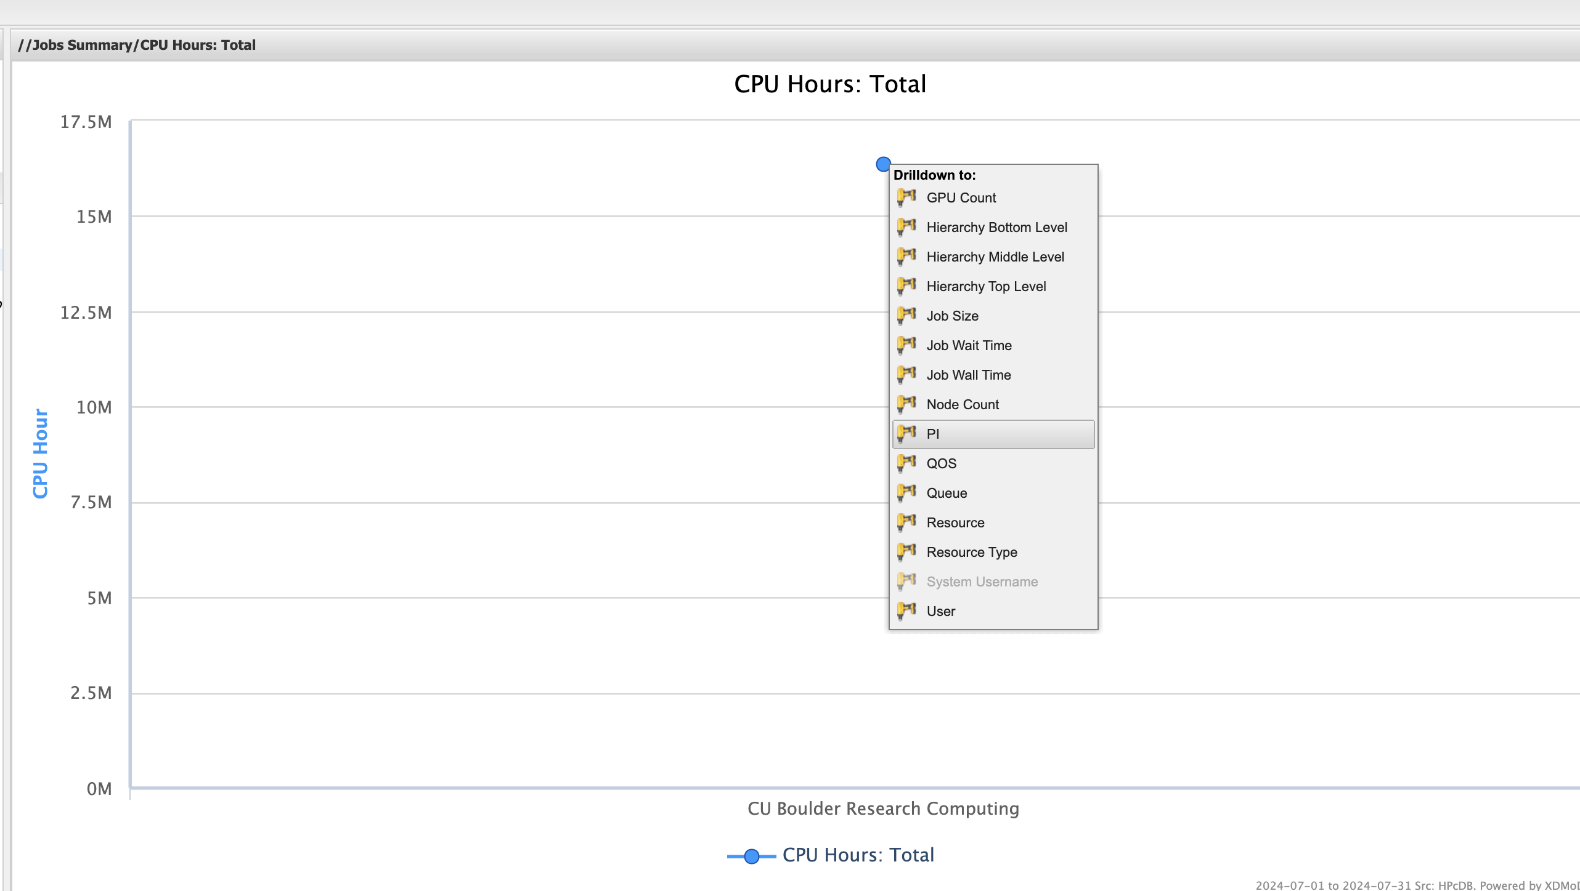
XDMoD Drilldown and Filter
Click on a data point to see Drilldown menu
(PI = Slurm allocation)
Filter and search

